Slide 1
Credit EDA Case Study (Group Case Study 1)
Prepared by:-
Utkarsh Upadhyay
Mayank Singh Soni

Slide 2
Univariate Analysis

Slide 3
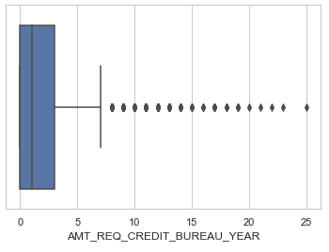
Distribution for AMT_REQ_CREDIT_BUREAU_YEAR
There exist outliers in the AMT_REQ_CREDIT_BUREAU_YEAR variable.
Median lies around 1, so we use mode to impute the missing values

Slide 4
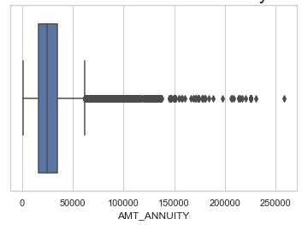
Distribution for Annuity
Plot shows that there are outliers in the AMT_ANNUITY column which is at the extreme end and can be removed from analysis

Slide 5
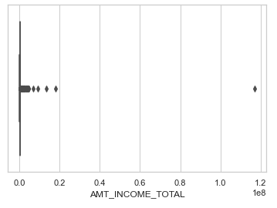
Distribution for Total Income amount
Total Income amount column shows outliers but the income vary from person to person.
We cannot remove this outlier.
It is better to create bins for it.

Slide 6
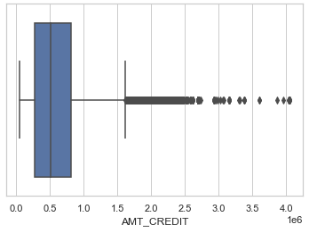
Distribution for Loan Credit Amount
Loan Credit amount column shows outliers but the income vary from person to person.
We cannot remove this outlier.
It is better to create bins for it.

Slide 7
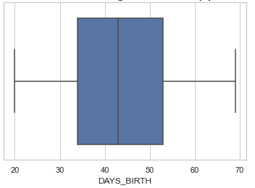
Distribution for Applicant Age
Applicant age data does not have any outliers.
It is well distributed from age 20 to age 70.
Most applicant are fall under age between 35 to 55.
Median lies around age of 43.

Slide 8
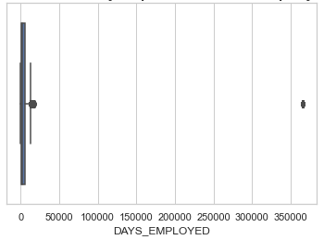
Distribution for applicant’s employed days
There is a outlier whose value is around 360000 days (i.e. 986 years approx.) which is false data. Thus, it needs to be removed.

Slide 9
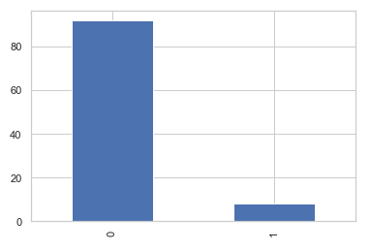
Distribution for target variable
By means of target variable, we can see that approx. 92% people had no difficulty in loan repayment and only 8% people had difficulty in loan repayment.

Slide 10
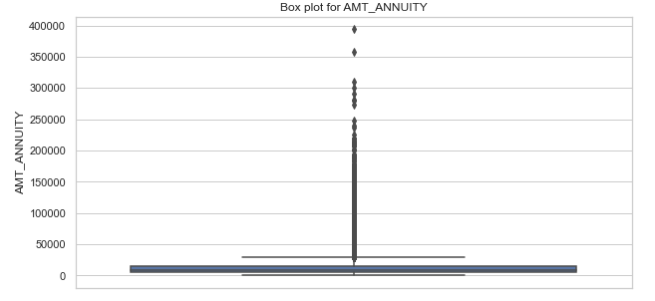
Distribution for previous annuity amount
There are outliers in the previous annuity amount data but annuity amount is also varies from applicant repaying capabilities (High wages/salaried person can afford high annuity amount)
It is better to be capped or binned

Slide 11
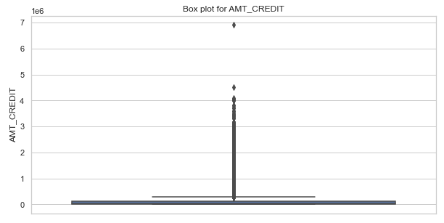
Distribution for previous credit amount
There are outliers in the previous credit amount data but credit amount is also varies from applicant repaying capabilities (High wages/salaried person can afford to high repay amount)
It is better to be capped or binned

Slide 12
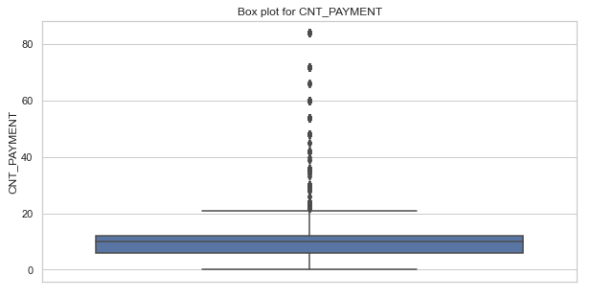
Distribution for previous payment count
There exist outliers in the data.
These are outliers are practically possible as a person can have long term EMIs for low EMI cost.

Slide 13
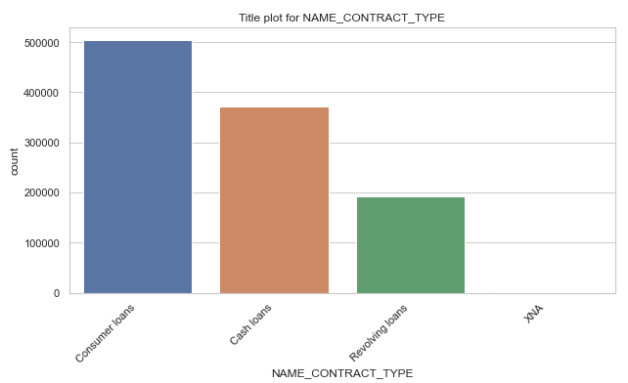
Distribution for Previous Contract Type
Clearly visible that there exist high number of consumers loans as compared to any other loans.

Slide 14
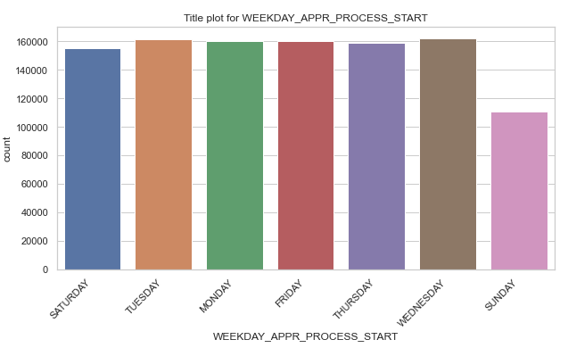
Distribution for
There are less loan application start on Sunday as compared to any other day.
All week days have approximately same numbers of process start.

Slide 15
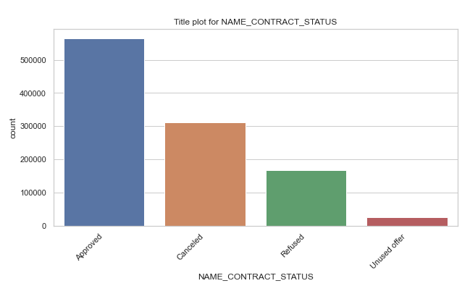
Distribution for previous contract status
There are high number of approved applications in the previous applications dataset.

Slide 16
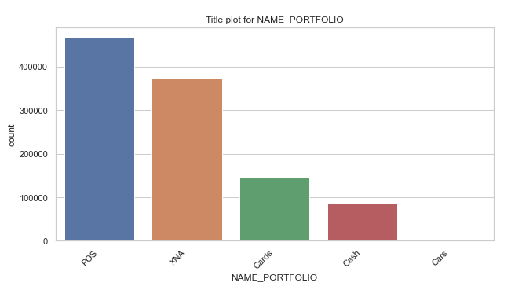
Distribution for previous portfolio
There are high number of POS based portfolio in the previous application dataset.

Slide 17
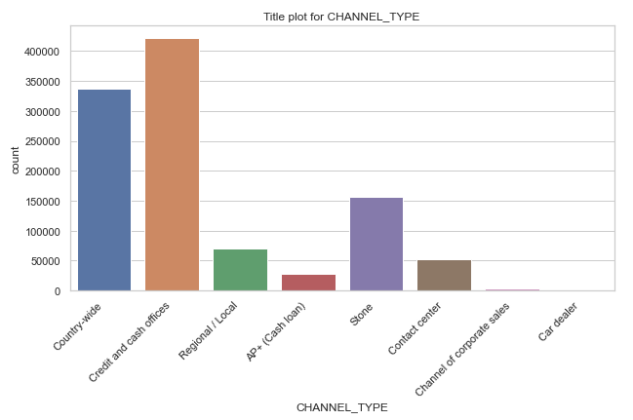
Distribution for previous channel type
There are high number of Credit and cash offices channel type as compared to any other channel.

Slide 18
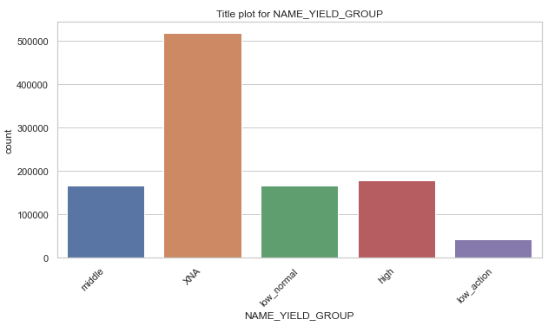
Distribution for previous yield group
There are more number of XNA yield group which can be ignored as it is logical not applicable.
After ignoring XNA, there is high number of high yield group as compared to any other group.

Slide 19
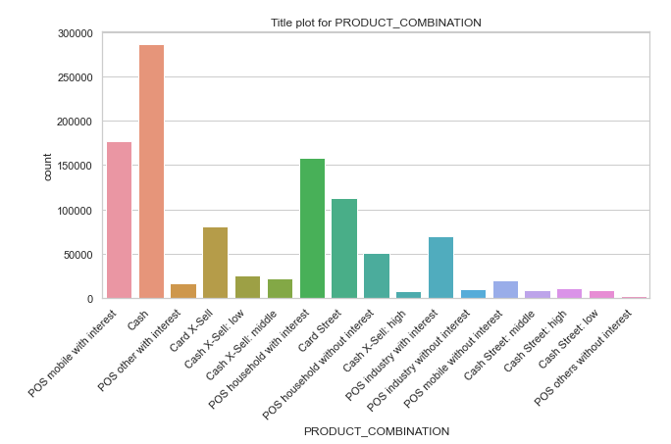
Distribution for
There is

Slide 20
Bivariate & Multivariate Analysis

Slide 21
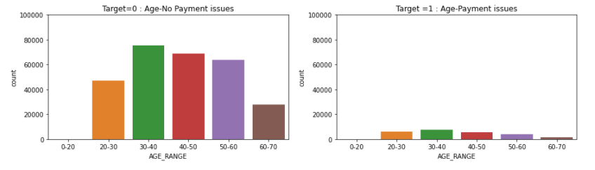
Age Vs Payment Issue
We can observe that customers belonging to age group 30-40 & 40-50 are able to make payment on time and can be considered while lending loan

Slide 22
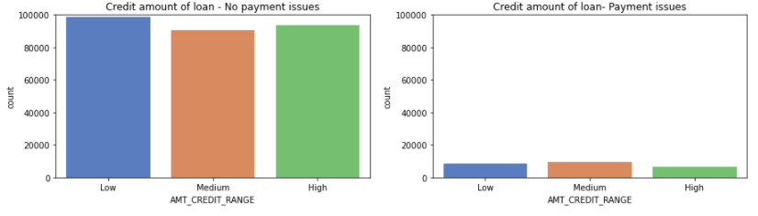
Credit Amount Vs Payment Issue
Customers with less credit and most likely to make payment. Customers having medium and high credit can also be considered while lending the loan.

Slide 23
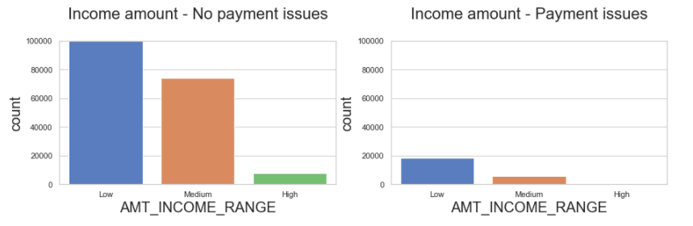
Income Amount Vs Payment Issue
as majority lies in low income range the stats shows that people from low-income range are able to repay the loan as compared to mid/high

Slide 24
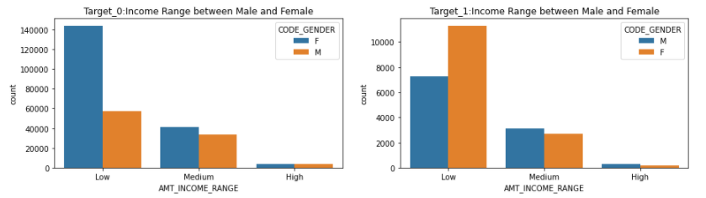
Gender Vs Income Range
Females with low income does not have payment issues

Slide 25
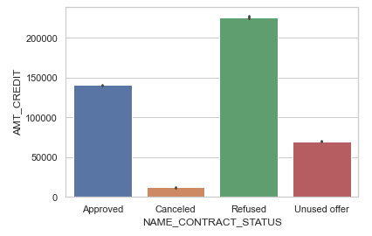
Distribution for Contract Status and Credit Amount
There is high change that loan application got refused or reject if the previous loan credit amount is higher.

Slide 26
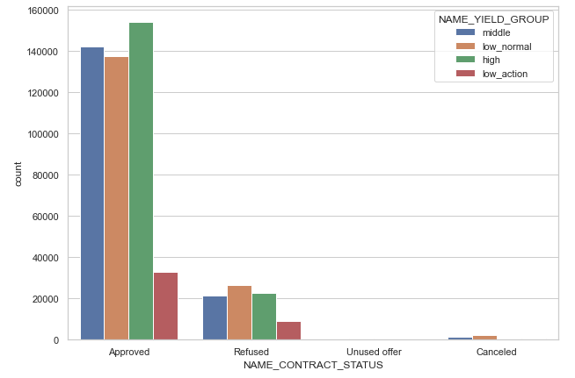
Distribution for Contract Status and Yield Group
High grouped interest rate has maximum number of approved loans
Low action grouped interest rate has least number of approved loans
In medium and low normal grouped interest rate, there are records with cancelled status which means if interest rate falls under medium or low normal group then there is chance that user cancel the loan application

Slide 27
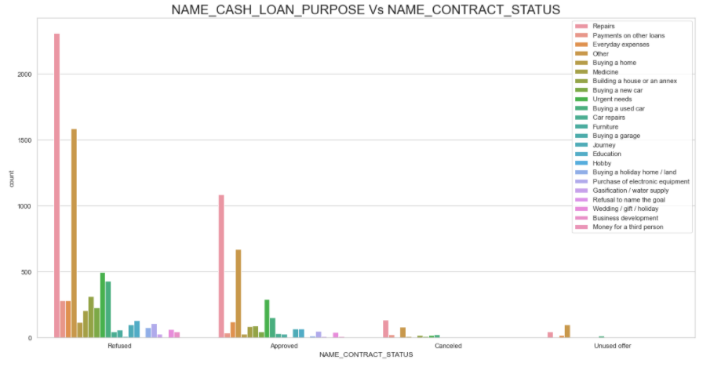
Distribution for Cash loan Purpose and Contract Status
There are high refused loan application for cash loan purpose of Repair and Everyday expenses.

Slide 28
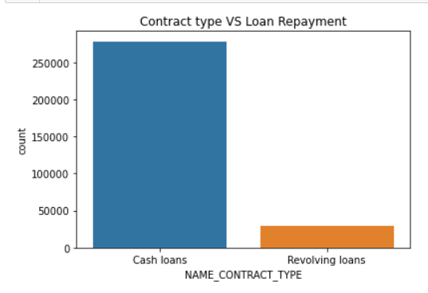
Revolving loans are just a small fraction from the total number of loans and are less repaid as compared to Cash Loans

Slide 29
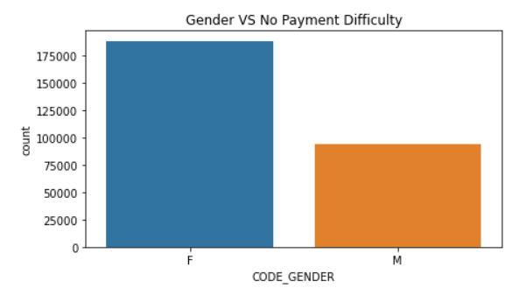
The number of female clients is almost double the number of male clients.
Based on the percentage of defaulted credits, males have a higher chance of not returning their loans as compared with women

Slide 30
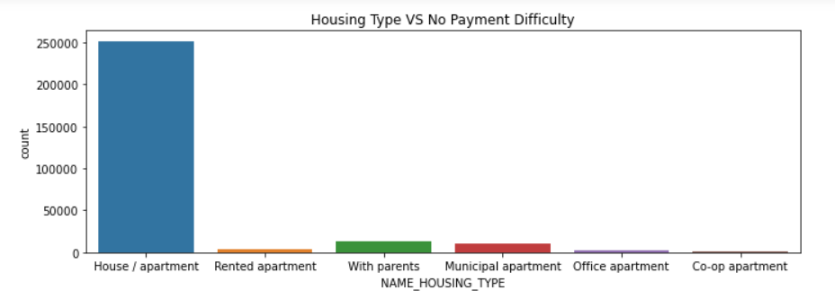
Majority of people live in House/apartment
People living in office apartments have lowest default rate

Slide 31
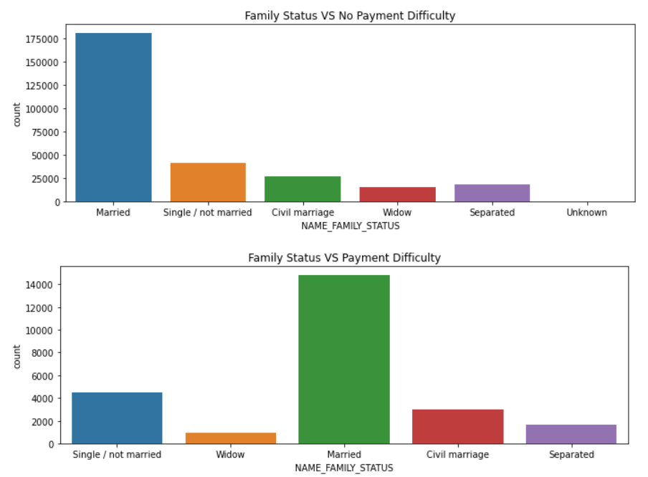
Family Status vs Loan Payment
Most of the people who have taken loan are married, followed by Single/not married and civil marriage

Slide 32
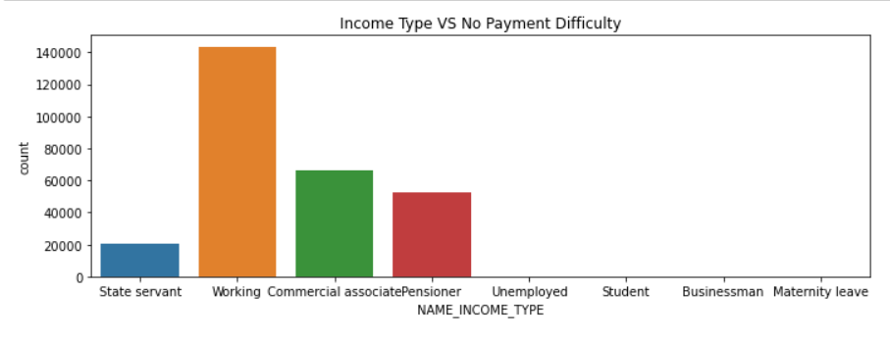
Income Type Vs Payment Difficulty
Most of applicants for loans have income type as Working, followed by Commercial associate, Pensioner and State servant.
Student and Businessmen, though less in numbers do not have any default record.

Slide 33
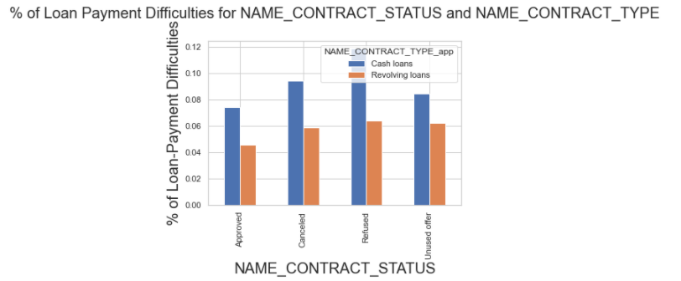
% of Loan Payment Difficulties for NAME_CONTRACT_STATUS and NAME_CONTRACT_TYPE
Percentage of rejection is high in cash loans
Percentage of approved loan for revolving loan is comparatively less.

Slide 34
Thank-You

